Slide 1

Perceptrons
Notes:
‹#›

Slide 2
Objectives
What is a perceptron?
How does a perceptron work?
When to use a perceptron?
Implementation details.

Slide 3
What is a Perceptron?
Supervised machine learning algorithm that is based on the neuron model concept.
Neuron model: neurons receive one or more input signals, which are then used to perform computations to arrive at an output.
Also known as a two-class (binary) classification machine learning algorithm.
Considered to be the simplest type of neural network.

Slide 4
How Does a Perceptron Work?
A number of features are passed in as input (number of features are stored in variable m).
Each feature is then multiplied by a respective weight.
The sum of the products is computed and results in the value z.
z is then passed into a function which will determine the classification output (+1 or -1 in the example).
Initially, resulting values will be incorrect and will be fed as input to an error function, which will then adjust the weights and iterate through the algorithm again until it meets the specified number of iterations through the algorithm.

Slide 5
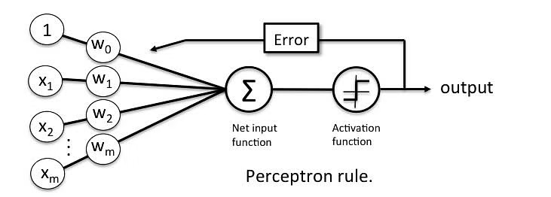
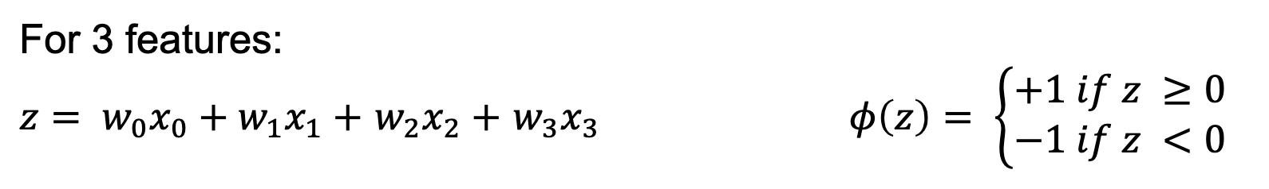
How Does a Perceptron Work?

Slide 6
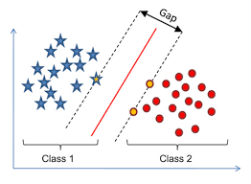
When to Use a Perceptron?
Perceptrons should be used when data needs to be classified into two parts.
When you have labeled data in a data set, the perceptron machine learning algorithm can be utilized to classify your data into two different outputs.
This is why the algorithm is known as the linear binary classifier.
Should ideally be used for linearly separable data.

Slide 7
Implementation Details
Iterate through all the samples to adjust the weights.
Epoch: an iteration through all the samples.
Set a limit for the number of epochs.
Epochs are used to help the model iterate through samples for training.
Make sure that the algorithm is being utilized on linearly separable data.

